Slide 1
Business Strategy Management
Course Code- 0413-202

Slide 2
Define strategic Management
Strategic management is the process of formulating and implementing strategies to achieve the goals and objectives of an organization.
# Example of Strategic Management
Strong Market Entry: Amazon entered the Indian market with significant investment and long-term vision, demonstrating its commitment to success. They strategically focused on building a robust logistics infrastructure, expanding product offerings, and offering competitive pricing.
Customer-Centric Approach: Amazon prioritized providing exceptional customer experience by offering fast and reliable delivery, easy returns, and a wide range of products. They leveraged their global expertise in e-commerce to create a seamless online shopping experience for Indian customers.

Slide 3
Continuous Innovation: Amazon introduced innovative features and services tailored to the Indian market, such as Hindi language support, regional content, and localized payment options. They constantly adapted their offerings based on customer feedback and market trends.
Competitive Pricing: Amazon employed a competitive pricing strategy to attract customers, offering discounts and deals on popular products. They leveraged their global scale and supply chain efficiencies to provide cost-effective solutions.

Slide 4
Strategic Partnerships: Amazon forged partnerships with local retailers, brands, and small businesses, enabling them to expand their product range and offer exclusive deals. This approach helped them tap into the vast Indian market and build trust among local sellers.
Investments in Technology: Amazon significantly invested in technology and data analytics to enhance customer personalization, improve operational efficiency, and drive insights for strategic decision-making.
These strategies allowed Amazon to differentiate itself, gain market share, and gradually surpass local players like Snapdeal and Flipkart in terms of customer trust, brand recognition, and market dominance.

Slide 5
# Task of Strategic Management
The strategy-making, strategy-implementing process consists of five inter-related managerial tasks:
1.Deciding what business the company will be in and forming a strategic vision of where the organization needs to be headed - in effect, setting the organization with a sense of purpose, providing long-term direction, an establishing a clear mission to be achieved.
2.Converting the strategic vision and mission into measurable objectives and performance targets.
3.Crafting a strategy to achieve the desired results.
4.Implementing and executing the chosen strategy efficiently and effectively.
5.Evaluating performance, reviewing new developments, and initiating corrective adjustments in long-term direction, objectives, strategy, or implementation in the light of actual experience, changing conditions, new ideas, and new opportunities.

Slide 6
# Strategic management process
The strategic management process can be broken down into five key stages.
1. Goal-setting
First thing’s first. Where do you want to go? Effective goal-setting involves understanding what your organization stands for and what it wants to achieve. For this, you’ll need your company mission, vision, and long-term objectives.
Begin by revisiting and deeply understanding your organization’s mission and vision. These are values that encapsulate the essence of what your organization is and aspires to be.
Think about how your goals can reflect and advance these fundamental principles in the long term. These values act as a guiding compass and should be evident in every goal you set. For example, if ‘innovation’ is a core value, your goals should reflect a commitment to new ideas.

Slide 7
Questions for goal-setting
• What are our key priorities, and how do they align with our mission and vision?
• How do our proposed goals reinforce our values?
• Are these goals ambitious yet achievable?
• How will these goals impact our employees, customers, and stakeholders?
• How will we measure the success of these goals?
2. Analysis
You need to know what you’re working with and what you’re up against. This involves looking inside your organization to understand your strengths and weaknesses and looking outside at the market and competitors to identify opportunities and threats. SWOT diagram will come in handy here. Use a template to make the process headache-free.
3. Strategy formulation
Here’s where you map your route. Based on what you’ve learned from your analysis, you work out how you’re going to reach your goals.
This could involve diversification, market penetration, product development, partnerships, cost leadership, or differentiation strategies, among others. The secret is to generate multiple options that align with the results of your SWOT diagram.

Slide 8
Not every strategy you mastermind will be viable. So as part of this step, you’ll need to critically assess the pros and cons of each option. Considerations include feasibility, value alignment, resource availability, market trends, and potential risks and rewards. Ask around so you get a range of perspectives and insight. Once you’ve gathered all you need, run it past management and decide on a strategy or mix of strategies that will best serve your goals.
4. Strategy implementation
Now, it’s time to put all that planning into action. The implementation stage involves allocating resources, assigning tasks, and making sure everyone in your organization knows what they’re supposed to be doing.
Using project management software can make this stage a lot easier. Instead of creating spreadsheets and sending out emails like wedding invites, simply add all your deadlines and tasks to a cloud-based timeline, then assign tasks and let the software do the heavy lifting when it comes to tracking.
5. Evaluation and control
As you move along, you need to check you’re still on the right path. This stage is about monitoring your progress, comparing it with your plan, and making adjustments like the captain of a ship. Maybe you’ve hit some unexpected challenges, or maybe there are new opportunities you hadn’t considered before. The more you check, the more you’ll know.

Slide 9
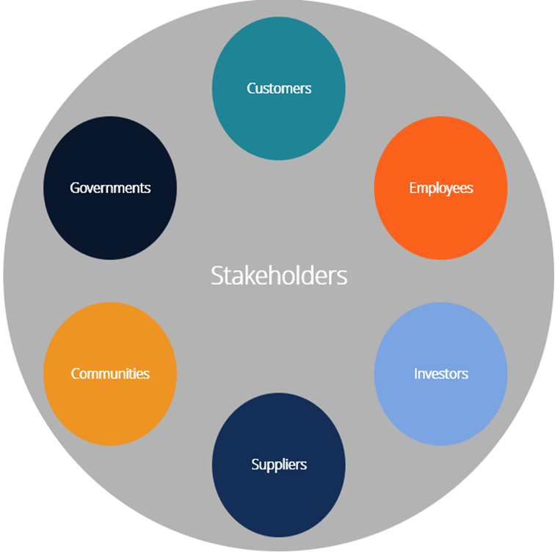
# What Is a Stakeholder?
A stakeholder is an individual or a group of individuals with an interest, often financial, in the success of a business. The primary stakeholders in a corporation include its investors, employees, customers, and suppliers.
Fig. Types of Stakeholders

Slide 10
#Types of Stakeholders
Customers
Stake: Product/service quality and value
Many would argue that businesses exist to serve their customers. Customers are actually stakeholders of a business, in that they are impacted by the quality of service/products and their value. For example, passengers traveling on an airplane literally have their lives in the of transportation, mining, oil and gas, construction, etc.). company’s hands when flying with the airline.
Employees
Stake: Employment income and safety
Employees have a direct stake in the company in that they earn an income to support themselves, along with other benefits (both monetary and non-monetary). Depending on the nature of the business, employees may also have a health and safety interest (for example, in the industries

Slide 11
Investors
Stake: Financial returns
Investors include both shareholders and debt holders. Shareholders invest capital in the business and expect to earn a certain rate of return on that invested capital. Investors are commonly concerned with the concept of shareholder value. Lumped in with this group are all other providers of capital, such as lenders and potential acquirers. All shareholders are inherently stakeholders, but stakeholders are not inherently shareholders.
Suppliers and Vendors
Stake: Revenues and safety
Suppliers and vendors sell goods and/or services to a business and rely on it for revenue generation and on-going income. In many industries, suppliers also have their health and safety on the line, as they may be directly involved in the company’s operations.

Slide 12
Communities
Stake: Health, safety, economic development
Communities are major stakeholders in large businesses located in them. They are impacted by a wide range of things, including job creation, economic development, health, and safety. When a big company enters or exits a small community, there is an immediate and significant impact on employment, incomes, and spending in the area. With some industries, there is a potential health impact, too, as companies may alter the environment.
Governments
Stake: Taxes and GDP
Governments can also be considered a major stakeholder in a business, as they collect taxes from the company (corporate income taxes), as well as from all the people it employs (payroll taxes) and from other spending the company incurs (sales taxes). Governments benefit from the overall Gross Domestic Product (GDP) that companies contribute to.

